Slide 1
Why is time representation important?
Imagine you have the task to plan the current and future energy supply in such way as to always meet the demand...
You are going to face some issues:
All characteristics of the energy system vary over different time scales (hours, days, weeks, seasons), both on demand and supply side.
Think for instance of:

Slide 2
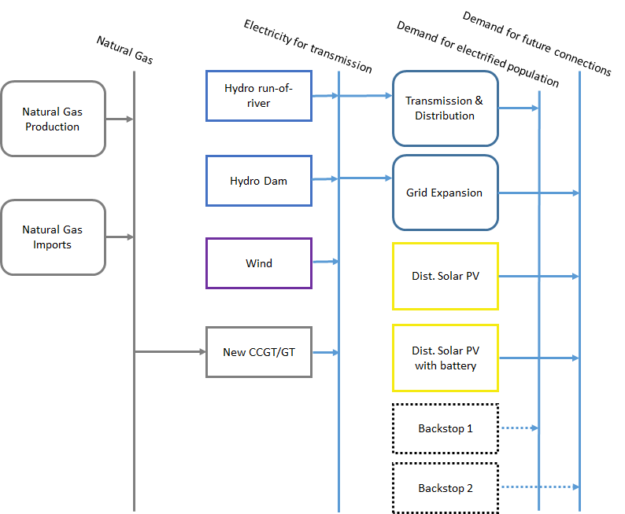
Why is time representation important?
Resources
Primary
Secondary
Final
Energy demand

Slide 3
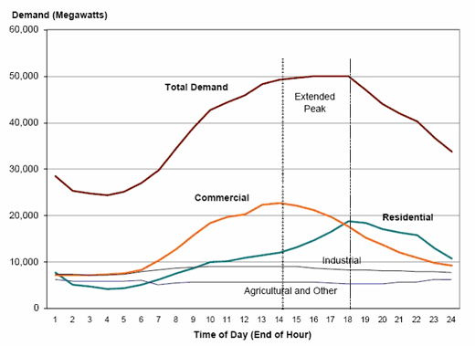
Variability of Energy Demand
In most cases energy demand is varying over time: consumers’ activities are different during the day/week/year;
In some cases it is important to model demand variations in order to supply energy at time when it is needed

Slide 4
Variability of Energy Demand - Seasonal

Slide 5
Variability of Energy Demand - Average Daily

Slide 6
Example: electricity demand
In each moment, the system has to be in balance:
Generation = Consumption + Losses
Electricity demand has significant variations (daily, weekly, seasonally etc.)
No economically viable way to store large quantities of electricity
Some technologies for electricity supply have limited flexibility in operation (nuclear, CHP etc.)
Electricity
(load curve)
Electricity Demand (MW)
Availability (%)
Water resources
(Availability)
0
8760

Slide 7
Why is time representation important?
Resources
Primary
Secondary
Final
Availability of energy supply technologies and storage;

Slide 8
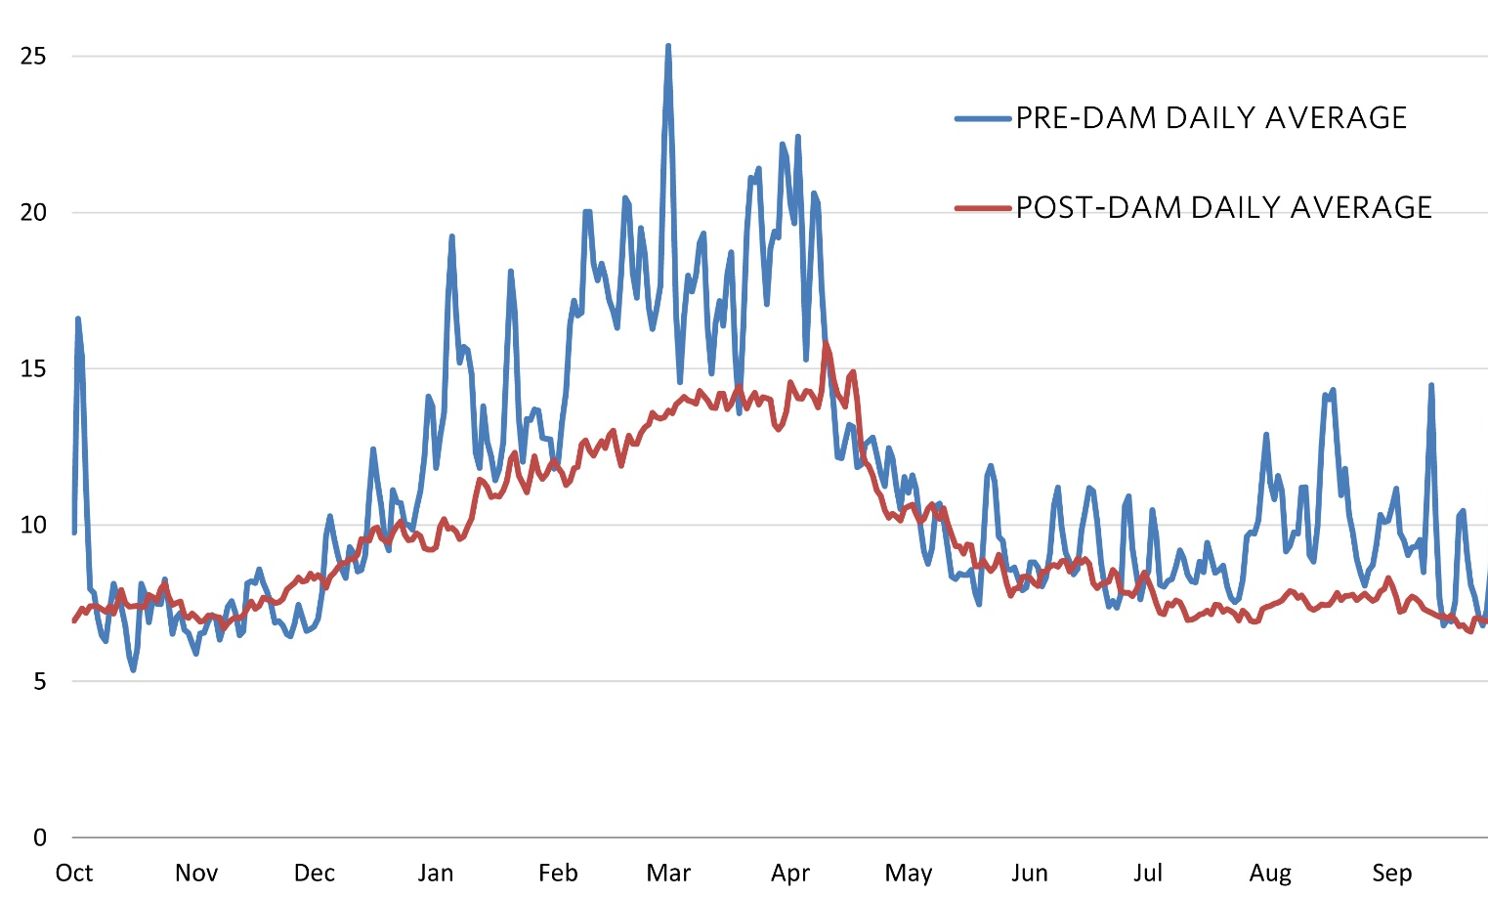
Operation of storages
Source: http://balancingthebasin.armylive.dodlive.mil

Slide 9
Why is time representation important?
Resources
Primary
Secondary
Final
Availability of renewable energy sources (water, irradiation, wind, etc...);

Slide 10
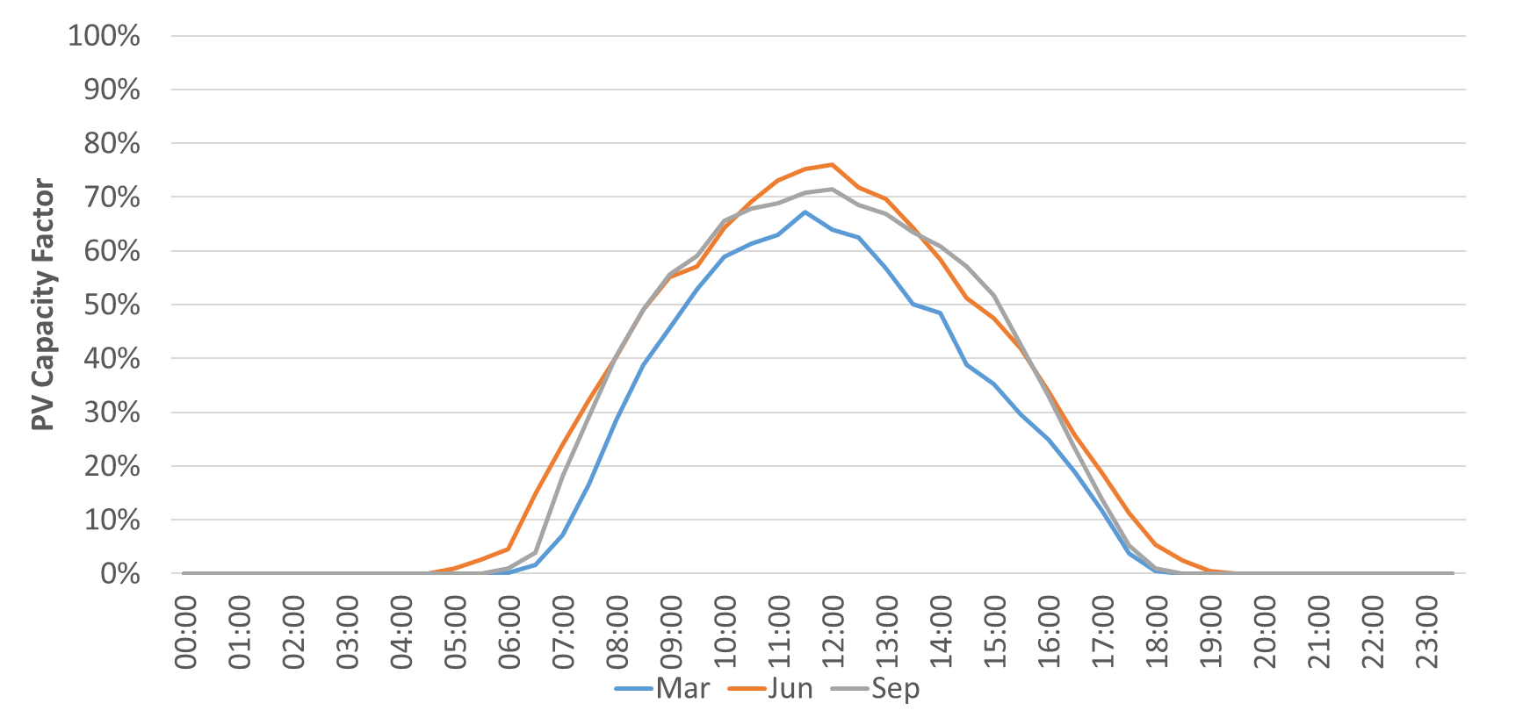
Availability of energy carriers and renewable resources

Slide 11
Why is time representation important?
Resources
Primary
Secondary
Final
Energy prices fluctuations.

Slide 12
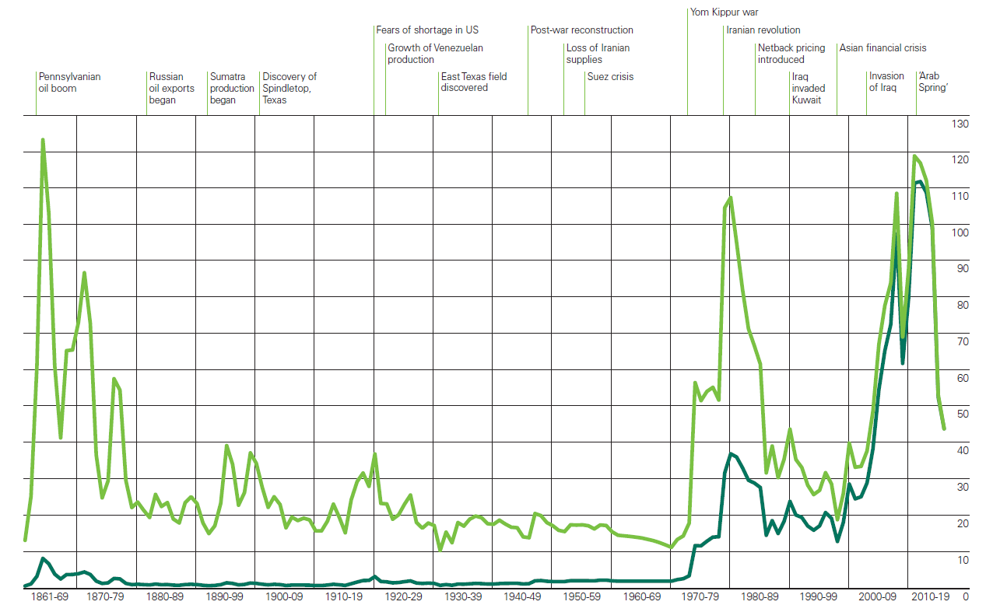
Energy prices fluctuations
Energy Prices
Years

Slide 13
Why is time representation important?
All characteristics of the energy system vary over different time scales (days, weeks, seasons), both on demand and supply side.
Think for instance of:
Energy demand;
Availability of energy supply technologies and storage;
Availability of renewable energy sources (water, irradiation, wind, etc...);
Energy prices fluctuations.
🡪 Need to ensure there is enough capacity to meet the demand

Slide 14
How to have time representation in an energy system model?

Slide 15
How to have time representation in an ESM?
We’ll divide one year into ’Time Slices’
Variation of different variables over time can be represented using the Time Slices
Time Slices are represented as Seasons, Days of the season (day types) and parts of the day (daily time brackets)
One set of Time Slices can be defined in OSeMOSYS for a case study and it is applied to every modelled year
Time Slices are characterized by their duration
Change of Time Slice definition when model already developed can cause problems and should be avoided or done carefully

Slide 16
Example: how to define time slices
Modeling period
–
5
years
S1
S2
S3
S4
S5
S6
One year
–
6
seasons
Working day
Weekend/Holiday
One season
–
2
day types
Day
Night
One day type
–
2
parts
24 Time Slices per year

Slide 17
How to define time slices?
Number of time slices must be large enough to take into account all important variations in the system (energy demand variations, supply side variations, availability of resources, etc.)
Number of time slices should not be too high in order to minimize problem size, data handling and computational efforts

